Slide 1

Learning Word Ratings for Empathy and Distress from Document-Level User Responses
Joao Sedoc, Sven Buechel, Yehonathan Nachmany, Anneke Buffone, and Lyle Ungar
(2020)

Slide 2
Problem Definition
Lexica characterizing different emotions have been shown to be very beneficial to NLP in that they improve sentence level emotion prediction, help refine pretrained word embedding models, and they are typically easy to acquire and have robust transferability.
Emotion analysis is becoming more popular in NLP, but creating lexica for concepts such as empathy is difficult.
There is no resource for empathy lexica because there are no clear set of words that can accurately distinguish empathy from self-focused distress.
The gold standard scale for empathy by Batson et al (1987) also is flawed, with words that have multiple meanings, where one meaning may relate to empathy while another may be far from empathy (“warm”, “tender”)
Notes:
Lexica characterizing different emotions have been shown to be very beneficial to NLP in that they improve sentence level emotion prediction, help refine pretrained word embedding models, and they are typically easy to acquire and have robust transferability.
Emotion analysis has been becoming more popular in NLP, but for psychological constructs such as empathy, it is very difficult.
There are many lexica for a range of emotions already, but for emotion, there are none because there are no clear set of words that can accurately distinguish empathy from self-focused distress.
The current gold standard scale for empathy from Batson et al in 1987 is also flawed, as it contains words with multiple meanings, where one meaning may relate to empathy while another may be far from it, such as in the case of “warm and “tender”, which could relate to feelings of love or compassion, or they could be used by a cannibal, or someone talking about their dinner. So this scale may be useful for self reporting emotional states, it would be a poor guide as a lexicon for empathy.

Slide 3
Creating lexica for abstract concepts
Previous work has worked with creating lexica for other abstract concepts such as concrete/abstractness, familiarity, imageability and humor, but not empathy (Brysbaert et al., 2014; Yee, 2017; Engelthaler and Hills, 2018).
Most lexica have been created manually, there is a large number of works on creating them automatically. (Kulkarni et al. 2019). However such papers focus primarily on word level supervision.
In this paper, the authors use document level ratings of empathy to learn word ratings.
Notes:
Previous work has worked with creating lexica for other abstract concepts such as concrete/abstractness, familiarity, imageability and humor, but not empathy (Brysbaert et al., 2014; Yee, 2017; Engelthaler and Hills, 2018).
Also, while most lexica have been created manually, there is a large number of papers published on creating them automatically. (Kulkarni et al. (2019)). However, these papers focus primarily on word level supervision. In this paper, the authors address the problems of making a lexica for empathy at the word level by taking a different approach. Instead, they use a document level approach to learn word ratings.

Slide 4
The goal
To learn ratings and create a lexica for two kinds of empathy, empathic concern (feeling for someone) and personal distress (suffering with someone)
To predict document level empathy in a regular supervised set-up, then invert the resulting model to derive word ratings.
Notes:
Now, with that background aside, our goal is to learn ratings and create a lexica for two kinds of empathy, empathic concern (feeling for someone) and personal distress (suffering with someone) and our goal is to predict document level empathy in a regular supervised set-up, then invert the resulting model to derive word ratings.

Slide 5

Defining our problem mathematically
let $W=\{w_{1},w_{2}, …, w_{n}\}$ denote a set of words with the gold labels $Y^{w}=\left\{y_{1}^{w},y_{2}^{w},…,y_{n}^{w}\right\}$
Let $D=\{d_{1},d_{2}, …,d_{m}\}$ be a set of higher-level linguistic units with gold labels $Y^{d}=\left\{y_{1}^{d},y_{2}^{d},…,y_{m}^{d}\right\}$
These higher-level linguistics units could be phrases, paragraphs, or even whole books, but we’ll just refer to them as documents for simplicity
We want to predict our $Y^{w}$ given $W$ $,D$, and $Y^{d}$
Notes:
So defining our variables, we let W = w1 through wn denote a set of words with the gold labels Yw for yw1 through ywn and we define D to be d1 through dm be a set of higher linguistic units with gold lablels Yd for yd1 through ydm
These higher level linguistics units could be phrases, paragraphs, or even whole books, but we’ll just refer to them as documents for simplicity
Keeping these variables in mind, we want to be able to calculate Yw, our word labels, given our W words, D documents, and Yd document labels.

Slide 6
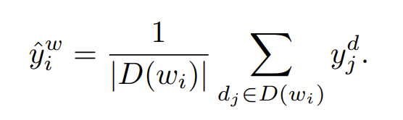

Methods – Mean Star Rating
Mean star rating predicts $Y^{w}$ by averaging the gold labels of documents $d_{j}$ in which the word $w_{i}$ occurs (Rill et al. 2012)
Notes:
The authors take a comprehensive approach at comparing different methods to solving this problem and their effectiveness. And to conserve time for other parts of the paper, I’m going to gloss over the specifics of the math formulas, and I’ll be focusing mostly on an overview of what they do.
Our first method, the mean star rating predicts word labels by averaging the gold labels of documents in which the word occurs

Slide 7
Methods – Mean Binary Rating
Mean Binary Rating looks at numerical document labels and applies a split at the median, with those below recorded as 0 and above recorded as 1. Then word rating labels are applied through the same equation as Mean Star Rating. (Mihalcea, R. and Liu, H. 2006)
Notes:
Mean Binary Rating looks at numerical document labels and applies a split at the median, with those below recorded as 0 and above recorded as 1. Then word rating labels are applied through the same equation as Mean Star Rating. (Mihalcea, R. and Liu, H. 2006)

Slide 8
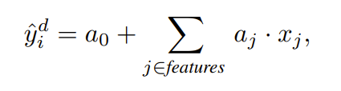
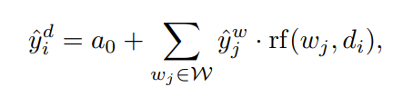

Methods – REGRESSION WEIGHTS
The Regression weights approach learns word ratings by fitting a linear regression model with bag of words features.
You consider a linear regression model that predicts document labels (Sap et al., 2014)
With a Bag of Words approach, relative frequency of a word is often used for the features. Aside from the intercept, the result of the linear model can be interpreted as getting the weighted average of all the weight terms $a_{j}$.
Because of this, a linear bag of words model will align with a lexicon approach for document level prediction, and you can substitute in the relative frequency of a word $w_{j}$ in a document $d_{i}$
Notes:
For the Regression Weights approach, the method learns word ratings by fitting a linear regression model with bag of words features. You consider a linear regression model that predicts document labels. With a Bag of Words approach, relative frequency of a word is often used for the features. Aside from the intercept, the result of the linear model can be interpreted as getting the weighted average of all the weight terms $a_{j}$ with the relative term frequency being the weighting factor. Because a linear bag of words model will align with a lexicon approach for document level prediction, you can substitute in the relative frequency of a word wj in a document di

Slide 9
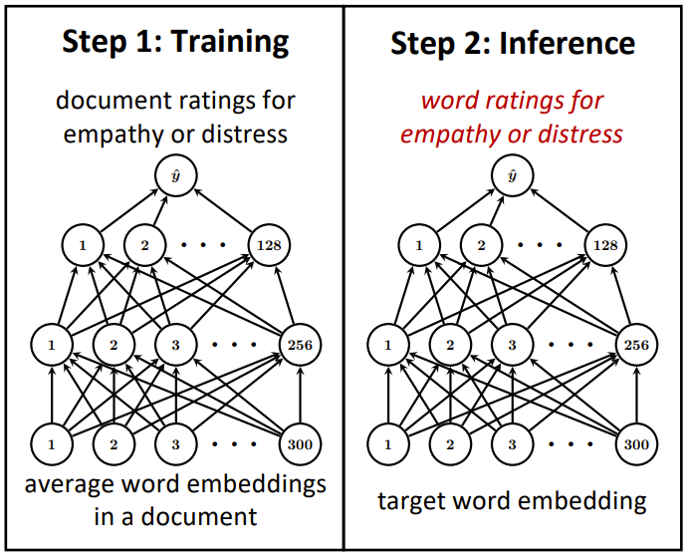

Proposed method: MIXED-LEVEL FEED FORWARD NETWORK
MLFFN is a feed forward network that predicts labels from embedding centroid features similar to deep averaging networks (DAN) (Iyyer et al. 2015)
The difference is that the model is used to predict word labels after it is fit to predict document labels.
The model learns to map the embedding space to the label space of documents
Because word and document labels populate the same space in the problem definition, the model can be used to predict both word and document labels
$$a^{(l+1)}=\text{σ}\text{(}W^{(l+1)}a^{(l)}+b^{(l+1)})$$
$${{\hat{y}}^{d}=a}^{(out)}=W^{(out)}a^{(out)}+b^{(out)}$$
$$a^{(0)}d_{i}=\frac{1}{len(d_{i})}\sum_{\text{ω}\text{∈}d_{i}}{vec(\text{ω})}$$
Notes:
The method proposed in the paper is a mixed level feed forward network. The math outlining the Mixed Level Feed Fordward Network in the paper is a little confusing at a glance, but the key takeaways are that this model is a feed forward network that predicts labels from embedding centroid features similar to deep averaging networks or DANs. The difference between this and DAN is that this model is used to predict words after being fit to predict document labels. By fitting, the model learns to map points of the pre-trained embedding space to the label space of documents. However, using this same embedding, we can also represent words wi in W, the ones we are wanting to predict labels for, in the same feature space. And because word and document labels populate the same space in the problem definition, the model can be used to predict both word and document labels. And so I want to highlight this, the most important part about these equations and what you should take away from it that makes this all work, is that you can predict each Ywi by inputting vec(wi) into the feed forward network equation you see here. Because this feed forward network can predict both the document labels and the word labels, they call it a mixed level feed forward network.

Slide 10
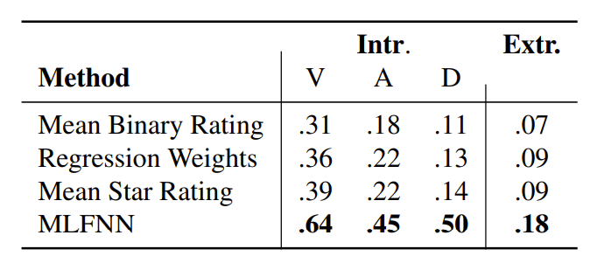
Systematic comparison of Methods
To test the methods, two approaches are taken, an intrinsic and extrinsic evaluation.
For the intrinsic approach, it is assumed that the affective variables valence arousal and dominance (VAD) will produce performance results transferable to empathy, and thus, these are evaluated for comparison, in the absence of an existing dataset for empathy
For the extrinsic approach, the Empathic Reactions dataset is used to create a lexicon for each method, then each is used to predict trait level empathy ratings.
Evaluation of lexicon learning methods in terms of Pearson correlation. Left group is on VAD (Valence Arousal Dominance ), right group is extrinsic evaluation on Twitter corpus annotated with person level empathy
Notes:
To test the methods, two approaches are taken, an intrinsic and extrinsic evaluation. For the intrinsic approach, it is assumed that the affective variables valence arousal and dominance (VAD) will produce performance results transferable to empathy, and thus, these are evaluated for comparison, in the absence of an existing dataset for empathy. For the extrinsic approach, the Empathic Reactions dataset is used to create a lexicon for each method, then each is used to predict trait level empathy ratings.
As you can see from the results measuring Pearson correlation, MLFNN greatly outperforms any of the other methods tested, often with double the performance.

Slide 11
Why MIXED-LEVEL FEED FORWARD NETWORK is better
The Mixed Level Feed Forward Network has a key advantage in that it builds on pretrained word embeddings and leverages large amounts of unlabeled text data.
The model has a great flexibility in that it can learn nonlinear dependencies between relative word frequencies of a document and the gold label
The model can predict ratings for any word for which embeddings are known, not just those that occur in the gold data
Notes:
The MLFFN has a key advantage in that it builds on pretrained word embeddings and leverages large amounts of unlabeled text data. The Mixed Level Feed Forward Network also has a great flexibility in that it can learn nonlinear dependencies between relative word frequencies of a document and the gold label. And the Mixed Level Feed Forward Network can predict ratings for any word for which embeddings are known, not just those that occur in the gold data. This means that it is particularly well suited to the task of labelling and creating lexica.

Slide 12
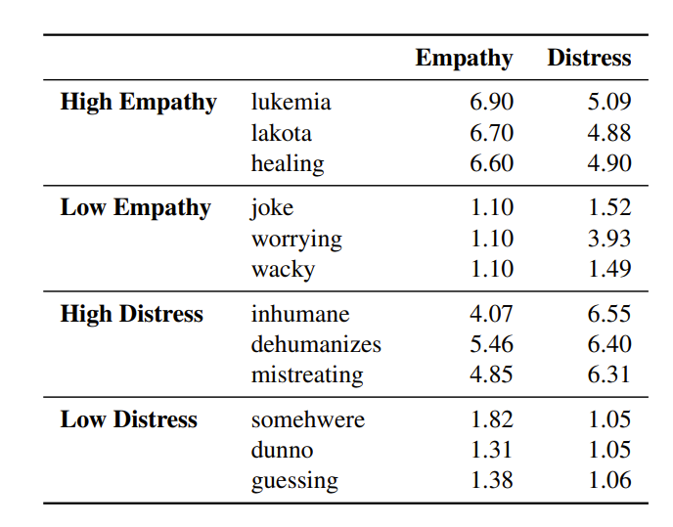
Creating The empathy Dictionary
Final lexicon consists of 9,356 word types
The High Empathy words group contains many references to named entities that experience or cause suffering, making the reader feel empathic.
Low empathy words group contains words relating to ridicule.
High distress words group contains words characterizing abusive behavior
Low distress words don’t show a clear pattern, showing that personal distress should be considered as a matter of distressing or neutral, rather than having words that are not distressing.
Examples from the resulting lexicon, showing the highest and lowest ranking words for empathy and distress.
Notes:
So, with the methods, the authors create the empathy dictionary. This final lexicon consists of 9,356 word types
The High Empathy words group contains many references to named entities that experience or cause suffering, making the reader feel empathic.
Low empathy words group contains words relating to ridicule.
High distress words group contains words characterizing abusive behavior
Low distress words don’t show a clear pattern, showing that personal distress should be considered as a matter of distressing or neutral, rather than having words that are not distressing. Funnily enough, the most commonly associated words for Low Distresss seem like the model is trying to tell us it has no idea what connection there is.

Slide 13
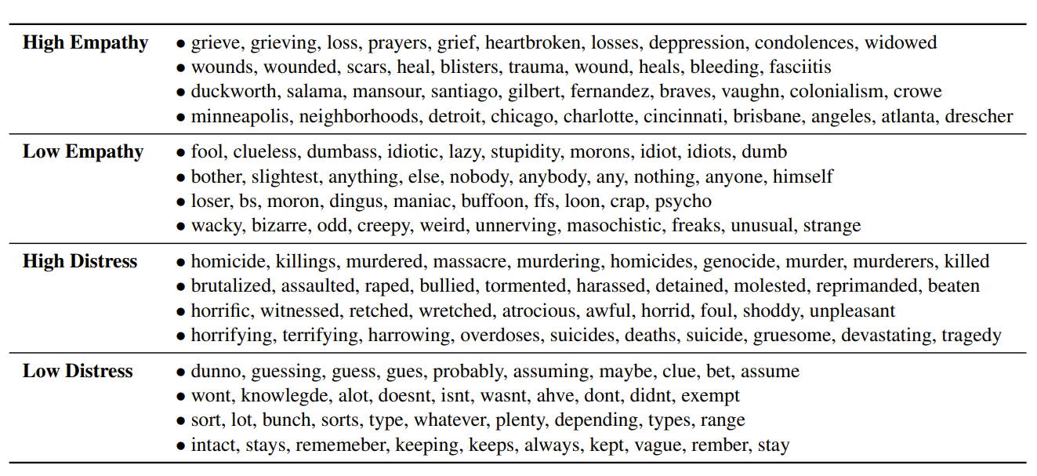
Clustering analysis
To give a more human interpretable lexica and verify the ratings, the authors perform a Signed Spectral Cluster to cluster words together that are similar semantically and in their ratings.
Clusters are shown to be very consistent, clustering around situations where people feel empathy.
The only clustering that seem strange are those surrounding named entities
It was not expected that named entities would be so prominent in the lexicon. However, the named entities clusters are somewhat representative of people and places where bad things happen, or to whom bad things happen that make people feel empathy. Thus, while the clustering are not useful for certain usages of the lexica, they are useful from a predictive standpoint.
Nevertheless, the prominent role of the named entities led to the authors wanting to estimate how many named entities there are in the lexicon.
Notes:
To give a more human interpretable lexica and verify the ratings, the authors perform a Signed Spectral Cluster to cluster words together that are similar semantically and in their ratings.
Clusters are shown to be very consistent, clustering around situations where people feel empathy.
The only clustering that seem strange are those surrounding named entities. As you can see, there is a clustering of duckworth, salama, mansour, santiago, gilbert, etc. which most of us would not immediately understand a connection between. It was not expected that named entities would be so prominent in the lexicon. Nevertheless, the named entities clusters are somewhat representative of people and places where bad things happen, or to whom bad things happen that make people feel empathy. Thus, while the clustering are not useful for certain usages of the lexica, they are useful from a predictive standpoint.
The prominent role of the named entities led to the authors wanting to estimate many named entities there are in the lexicon.

Slide 14
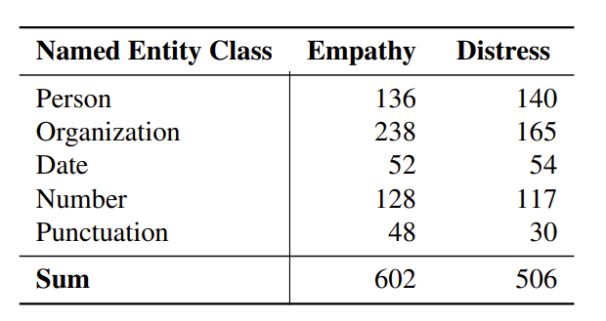
Investigating Named entities
The authors manually labelled the clusters produced as person, organization, date or time, number or unit of measurement, and punctuation.
Clusters that contained mostly entries of one of these labels were marked with all of their words belonging to the label.
Named entities are very consistent in being grouped together, but some false positives and negatives occur, meaning their estimates will be slightly off.
In the end, they found that the ratio of named entities was roughly 6%
Notes:
The authors manually labelled the clusters produced as person, organization, date or time, number or unit of measurement, and punctuation.
Clusters that contained mostly entries of one of these labels were marked with all of their words belonging to the label.
Named entities are very consistent in being grouped together, but some false positives and negatives occur, meaning their estimates will be slightly off.
And from the table on the right, we can see that for the most part, there aren’t any significant differences between the number of named entities for empathy compared to distress, except for with regard to organizations. The authors don’t comment on this pronounced difference, but my hypothesis would be that there are likely more distinct organizations dedicated towards helping those who are suffering and organizations of people who are suffering than there are those that make us feel distressed at their mentioning. The authors also don’t talk about the difference in punctuation at all. I also have no idea why punctuation would have a 60% increase from distress to empathy, but I would be curious if anybody had ideas on this.
Besides the point, after they completed their estimations, they found that the number of named entities in their dictionary was roughly 6%

Slide 15
Conclusion and Takeaways
Mixed-Level Feed-Forward Network learns word ratings from document level ratings and performs substantially better than other methods previously used for lexicon creation.
The Mixed-Level Feed-Forward Network builds on pre-trained word embeddings, leveraging vast amounts of unlabeled text data
The model learns nonlinear dependencies between word frequencies and the label
The model can predict ratings for any word for which embeddings are known
Notes:
Mixed-Level Feed-Forward Network learns word ratings from document level ratings and performs substantially better than other methods previously used for lexicon creation.
The Mixed-Level Feed-Forward Network builds on pre-trained word embeddings, leveraging vast amounts of unlabeled text data
The model learns nonlinear dependencies between word frequencies and the label
The model can predict ratings for any word for which embeddings are known

Slide 16
Citations
Brysbaert, M., Warriner, A. B., and Kuperman, V. (2014). Concreteness ratings for 40 thousand generally known English word lemmas. Behavior Research Methods, 46(3):904–911.
Engelthaler, T. and Hills, T. T. (2018). Humor norms for 4,997 English words. Behavior Research Methods, 50:1116–1124.
Iyyer, M., Manjunatha, V., Boyd-Graber, J., and Daume III, ´ H. (2015). Deep unordered composition rivals syntactic methods for text classification. In Proceedings of the 53rd Annual Meeting of the Association for Computational Linguistics and the 7th International Joint Conference on Natural Language Processing (Volume 1: Long Papers), pages 1681–1691, Beijing, China, July. Association for Computational Linguistics
Kulkarni, P. V., Nagori, M. B., and Kshirsagar, V. P. (2019). An in-depth survey of techniques employed in construction of emotional lexicon. In Information and Communication Technology for Intelligent Systems. Proceedings of ICTS 2018, Volume 1, pages 609–620, Ahmedabad, India, April. Springer.
Mihalcea, R. and Liu, H. (2006). A corpus-based approach to finding happiness. In Computational Approaches to Analyzing Weblogs, Papers from the 2006 AAAI Spring Symposium, Technical Report SS-06-03, pages 139–144, Stanford, USA, March. Association for the Advancement of Artificial Intelligence (AAAI)
Rill, S., Drescher, J., Reinel, D., Scheidt, J., Schuetz, O., Wogenstein, F., and Simon, D. (2012). A generic approach to generate opinion lists of phrases for opinion mining applications. In Proceedings of the First International Workshop on Issues of Sentiment Discovery and Opinion Mining, Beijing, China, August. Association for Computing Machinery.
Sap, M., Park, G., Eichstaedt, J., Kern, M., Stillwell, D., Kosinski, M., Ungar, L., and Schwartz, H. A. (2014). Developing age and gender predictive lexica over social media. In Proceedings of the 2014 Conference on Empirical Methods in Natural Language Processing (EMNLP), pages 1146–1151, Doha, Qatar, October. Association for Computational Linguistics.
Yee, L. T. S. (2017). Valence, arousal, familiarity, concreteness, and imageability ratings for 292 two-character Chinese nouns in Cantonese speakers in Hong Kong. PLoS one, 12(3):e0174569.

